Slide 1
Level 3
CORE MATHEMATICS
What does this qualification cover?
Level 3 Core Maths is a qualification for Post 16 Study, sitting in between GCSE and A-Level Mathematics. The course was designed to enhance GCSE skills, developing them further with a focus on application in real life context.
Assessment
The course is assessed at the end of the year 13 and is 100% exam based. The assessment consists of two papers, both of which are calculator. The course is worth the equivalent of half an A-Level and combines well with Extended Project Qualification (EPQ).
Paper 1 – Mathematical Comprehension (40% of the qualification)
Paper 2 – Mathematical Applications (60% of the qualification)
Type | Topics Cover
Application of Statistics | Populations, distributions and Sampling Time series and moving averages Statistical diagrams Analysing distributions and spreads Correlations and distributions
Probability | Probability of events, limitations and bias Set theory and Venn Diagrams Independent and Dependent events Probability Diagrams Interpretation of risk
Linear Programming | Simultaneous equations Algebraic modelling Graphical modelling and solutions Linear and quadratic functions
Sequences and Growth | Growth and decay Repeated percentage change Sketching of functions Arithmetic and Geometric sequences
What’s included

Slide 2
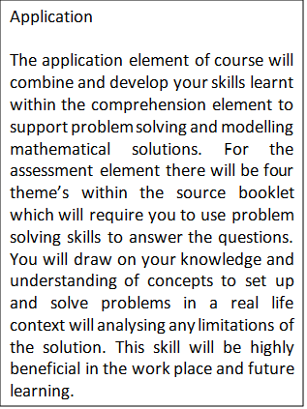
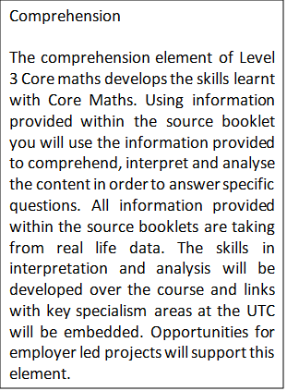
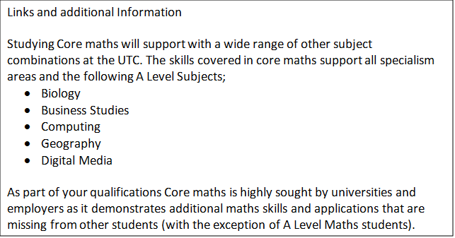
Key Features
Level 3 Core Mathematics builds upon the skills that you will have learnt at GCSE. There is a greater emphasis on problem solving skills and applying mathematics to solving problems effecting your everyday life. This includes areas such as: financial mathematics and using statistics to analyse data. Critical thinking and communication skills will also be developed.
Links to workplace
The skills developed through the study of mathematics are becoming increasingly more important in the workplace and higher education. Universities are welcoming of the skills developed in Core Mathematics as students will be better prepared, equipped with the mathematical skills required for some areas of study. These include:
Teacher training,
Sciences,
Computing,
Nursing and Midwifery,
Geography.

