Slide 1




Cambridge Nationals level 1/2
CREATIVE iMEDIA DIGITAL MEDIA
What does this qualification cover?
The media is a vital part of our everyday lives and vital to the UK economy. Production of digital and media products is a a major industry and one of the key areas of employment for many creatives in the UK>.
By studying the L2 Creative iMedia Certificate – Digital Media, you will choose to learn about media production allowing you to pursue a L3 qualification in Digital Media or Film Studies. The qualification is equivalent to studying one GCSE.
You will take four units: two mandatory that help you plan a digital product and learn technical graphics, and two that allow you develop your web and app development skills.
The two mandatory units are: R081 Pre-production skills and R082 Creating Digital Graphics.
You will be working with local and national digital companies as part of the units you study, and completing employer led projects throughout the course.
Unit R081: Pre-production skills
This first unit underpins the other learning in this qualification. You will learn about how to plan pre-production effectively including understanding of client requirements and reviewing pre-production briefs. You will use this knowledge in the optional units when they develop your own digital media products.
Unit R082: Creating digital graphics
Digital graphics are a key part of most digital products and this mandatory unit will help support your other units. You will learn the basics of digital graphics editing for the creative and digital media sector, considering client requirements that you learnt about in R081.
You will be working with employers to develop your skills in digital video editing, photography and graphic design. You will also learn how to storyboard, write scripts and how to plan and plan a digital media production. You will also develop your communication skills.
What’s included

Slide 2
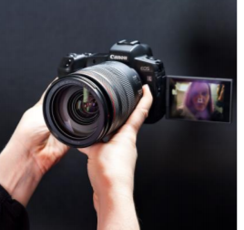
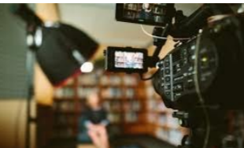
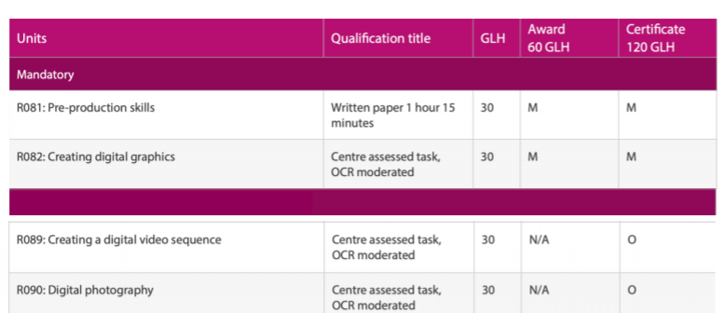
R089 Creating a digital video sequence
Digital video is used in a range of products like games, websites or television productions. You will explore uses of video products and then plan and produce a digital video sequence to meet an UTC employer partner brief.
R090 Digital photography
In this unit you will learn about different
types of photography equipment, features and settings. You will then plan and execute a photoshoot based on a brief set by a UTC employer partner.
Key Features
Graphic design
Photography
Storyboarding
Scriptwriting
Communication skills
Teamwork
Video editing
Sound editing
,
Links to workplace
Digital marketer
Media planner
Music producer
Public relations officer
Runner, broadcasting
Social media manager
Television/film/video producer
Web content manager

