Slide 1
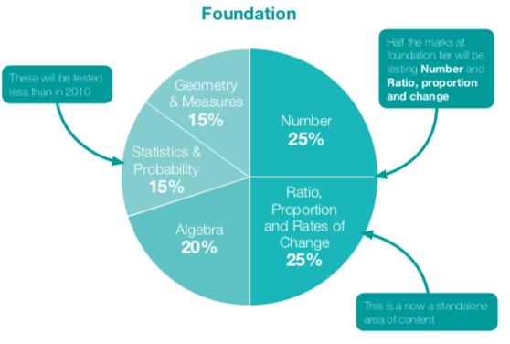
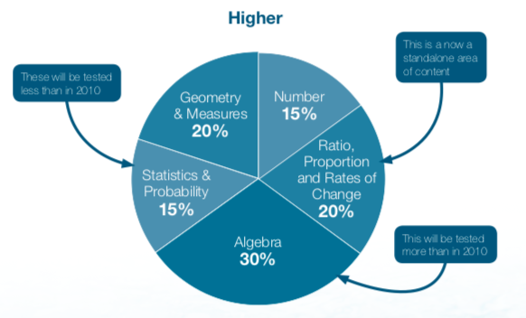
GCSE
specification
MATHEMATICS
What does this qualification cover?
GCSE mathematics is split across Higher and Foundation Tier. Breakdowns of the content are shown with the diagrams below. Over the GCSE course there is a large focus of the ability to problem solve. Topics are interlinked within questions so that a single question can include up to 4 different topic areas within the question.
Teachers at Doncaster UTC deliver maths using the Concrete, Pictorial and Abstract approach which develops understanding of mathematical topics and concepts through a range of physical resources, pictorial / diagrammatical representations and the abstract methods.

Slide 2
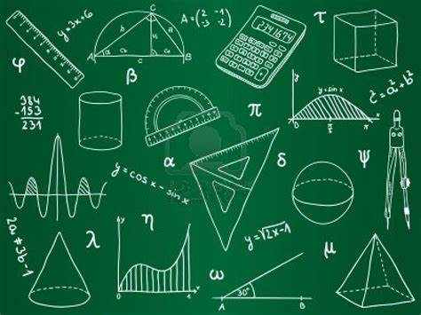
Assessment
Assessment for GCSE Mathematics is split across three exams at the end of course. This is split of one non calculator and two calculator papers, each of worth 80 marks.
Content is split across the papers so that any topic can appear on any paper. A breakdown of the areas is shown below
Topic Area | Foundation | Higher
Number | Four Operations Converting between Fractions, Decimals and Percentage Factors, Multiples and Primes | Factors, multiples and primes Indices Surds Standard form Operations with percentages
Ratio and Proportion | Conversion of units Working with ratio Direct and Indirect proportion Calculating rates of change | Conversion of units Compound measures Manipulation’s with ratio Iteration Direct and inverse proportion
Algebra | Manipulating expressions Solving Equations Calculations with formula Linear Graphs Sequences | Manipulating expressions Quadratic equations Manipulating formulae Exploring linear and quadratic graphs
Geometry and Measures | Constructions Transformations Calculating Angles Pythagoras Trigonometry Circle Perimeter, area and volume Simple vectors | Angles in polygons Constructions and loci Congruence Transformation’s and enlargements Circle theorems Pythagoras and Trigonometry including 3D Perimeter, area and volume
Statistics and Probability | Calculate probability of events Experimental probability Probability tables Venn diagrams Averages Bar Charts Pie Charts | Experimental probability Conditional and mutually exclusive probability Venn diagrams and set theory Sampling Cumulative frequency and box plots Histograms
Key Features
GCSE maths will provide you with a plethora of transferable skills, which are highly valued by employers. Areas that you will develop include:
Problem solving,
Critical thinking,
Analytical skills
The ability to understand statistics and data,
Financial skills,
Being able to communicate effectively and clearly,
Resilience when faced with difficult problems
Links to workplace
A good GCSE qualification in mathematics are highly sought after by employers.
Careers that will utilize mathematics include:
Careers in finance including accountancy, actuary, banking and statistical analysis,
Sciences,
Engineering,
Architecture,
Medincine
Computing,
In addition to this having a solid qualification at GCSE mathematics will open access to many routes of study post 16.

