Slide 1
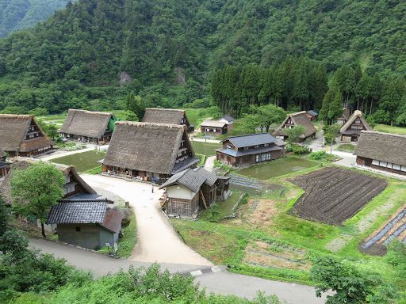
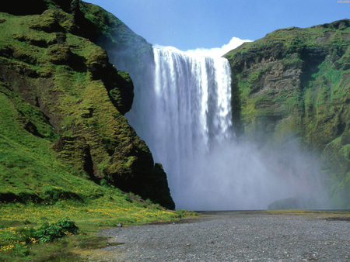
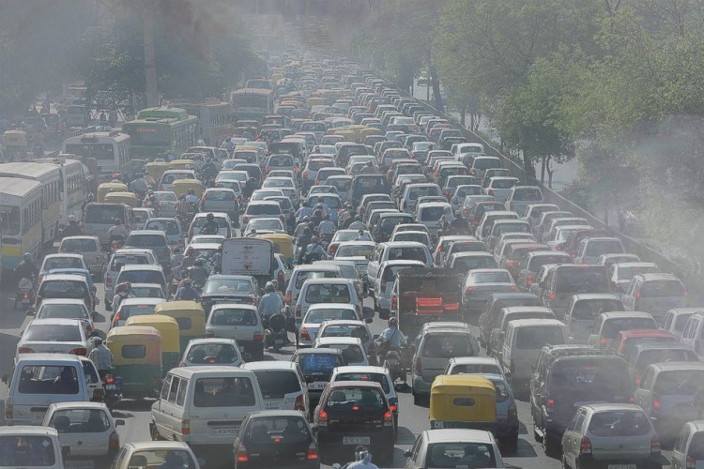
Cambridge Nationals
Geography
What does this qualification cover?
The aim of the course is to provide a holistic experience of how geography shapes the world around us today. This is achieved by developing an understanding of physical processes, human influence and hands on, practical fieldwork.
What makes a Geographer?
What will I study?
Living in the physical environment
Within this unit the focus is upon physical geography. The unit will explore the cause and effect of tectonic and weather hazards examining how the impacts of these differ around the world. The challenge posed by climate change is also covered as well as a focussed study on specific biomes of the world.
Challenges in the human environment
Within this module, there is a focus on the continued growth of urban areas around the world and the challenges this poses for governments now and in the future. Economic development is explored and the measures being taken to close the development gap examined. There is also a focus on the challenge of meeting resources demand with an ever expanding global population.
Geographical applications
Here, critical skills required in the field of geography are developed such as fieldwork, data analysis and presentation, cartographic skills and the ability to process pre-released information in preparation for examination.
A geographer’s key to success is to be inquisitive about the world around them. You will use evidence to understand the processes behind how the things we see around us have come to be.
Geographers are scientific in their thinking and embrace problem solving – thinking of innovative ways to answer the questions posed by nature and human behaviour.
Geographers have an ability to think critically and recognise how the same issues can be dealt with in very different ways around the world, dependent upon culture and economic development.
Geographers are reflective and recognise how their own behaviours can impact upon the environment that surrounds them and the lives of others.
Thinking analytically is key. Geographers are adept at using numerical data to recognise patterns and explain processes to further their understanding of the world around them.
Assessment Method There are three externally assessed examinations set by the exam body AQA, which are sat at the end of the three year course..

Slide 2
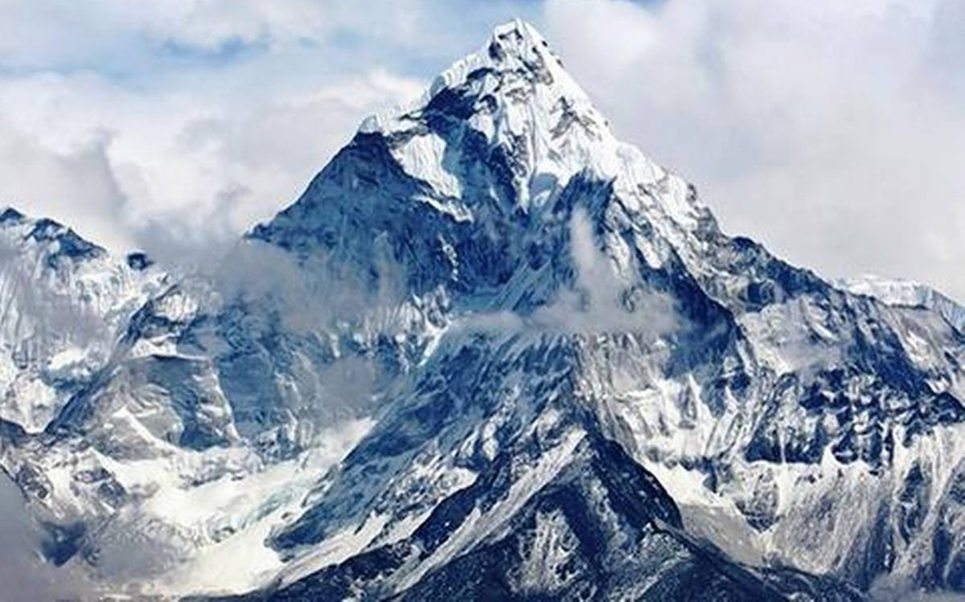
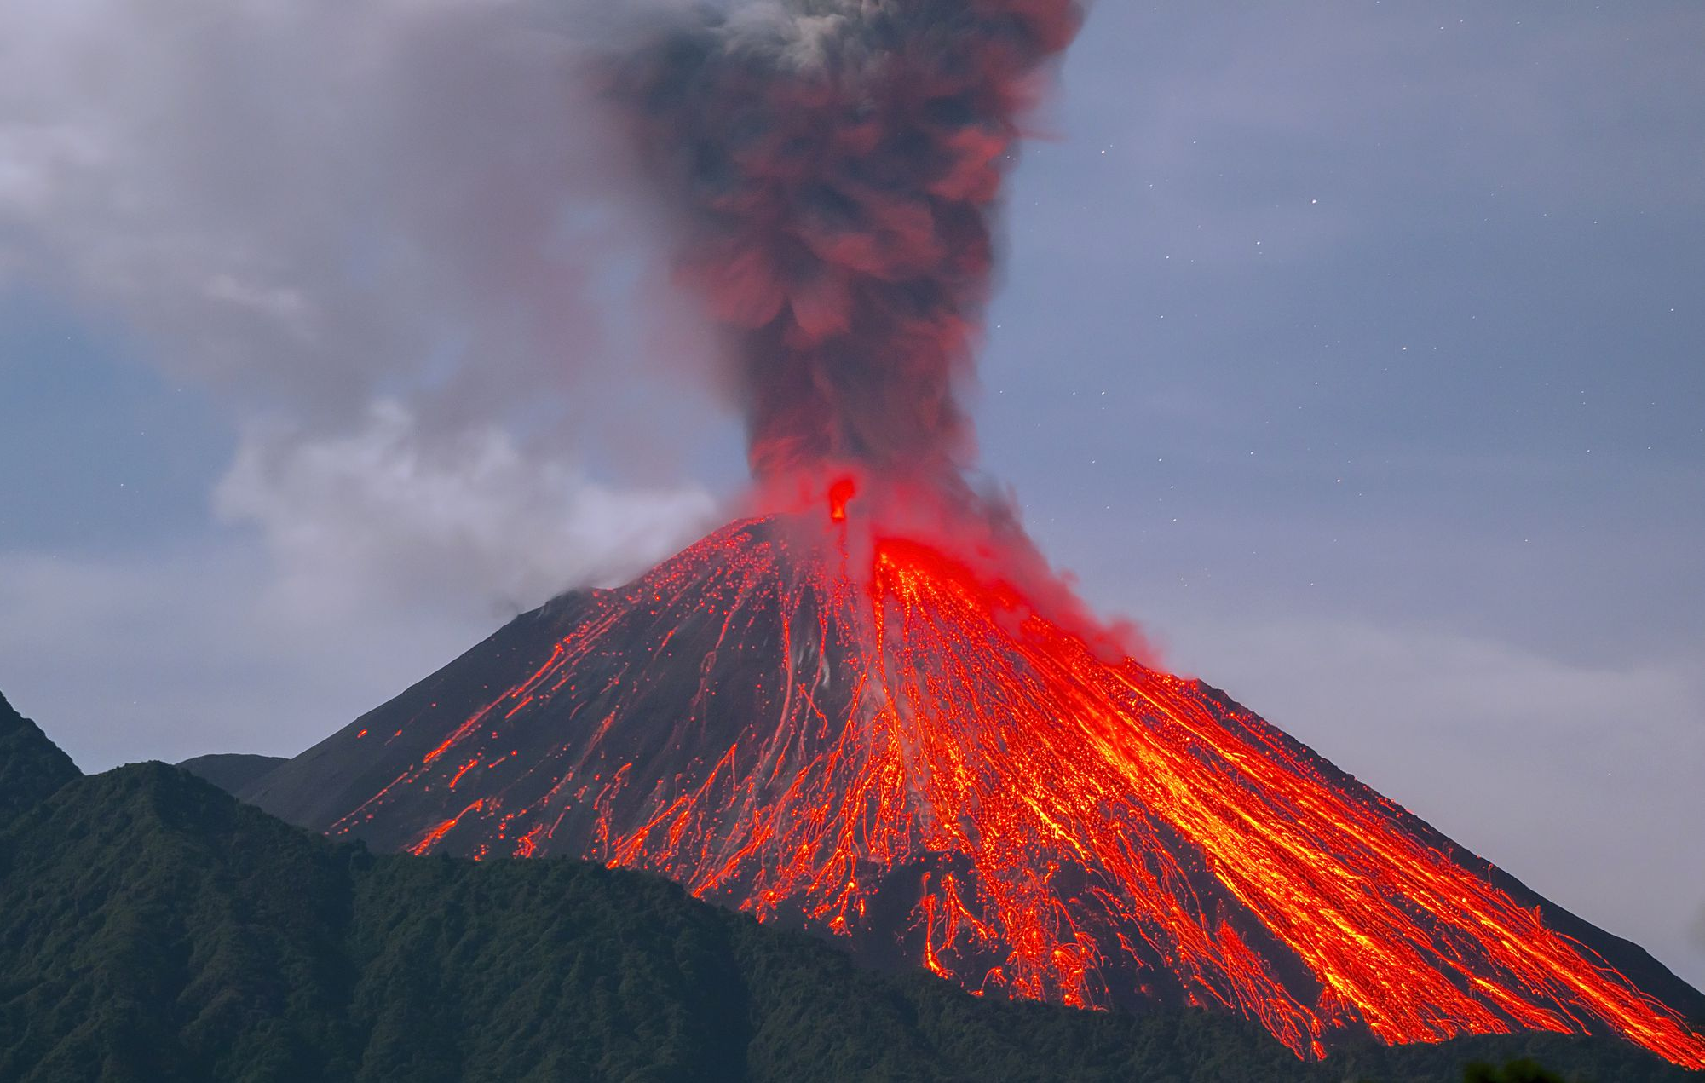
Assessment
Employability skills
Geography provides many key skills that employees find desirable in their applicants:
Critical and analytical thinking,
Presentation and debating skills,
Numeracy and graphicacy skills,
Problem solving abilities,
Well developed literacy skills,
An ability to work well individually and in collaboration,
An understanding of global systems and processes,
Creative thinking skills.
Future employment pathways
The study of GCSE geography can lead into numerous pathways in the future:
GIS and computer science,
Architecture, building and planning,
Education,
Business and communications,
International relations,
The oil industry,
Meteorology,
Geology,
Engineering,
Agriculture.

