Slide 1
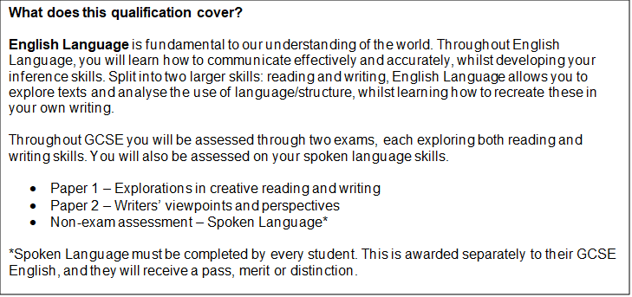
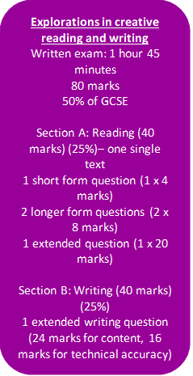
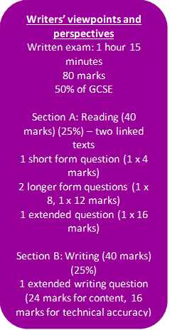
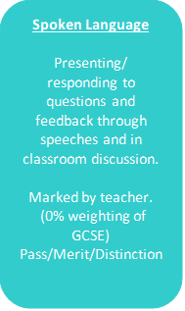
GCSE
ENGLISH LANGUAGE
What’s included
Throughout the course you will study multiple extracts, across the nineteenth century to the twenty-first. These will be fiction and non-fiction. You will also learn how to create successful narratives and descriptives, and how to persuade and inform multiple audiences through letters, articles and speeches.

Slide 2
What jobs might this lead to?
As a core subject, most career pathways require a good grade within English Language. Communicating well, writing accurately and arguing your viewpoints on a matter of importance are excellent skills to have in any field of work.
Key Features
You will develop and enhance skills such as:
Critical analysis
Accurate spelling, punctuation and grammar
Analytical thinking
Perceptive understanding
Independent working
Verbal and written communication
Sophisticated expression when articulating knowledge
Negotiation and teamwork
Imagination and creativity
Time management and organisation
Links to workplace
Possible roles and responsibilities requiring English Language:
Creating reports/documents
Dealing with the public or customers
Developing presentations and pitches
Writing/editing contracts
Promoting goods to companies/the public
Delegating to/leading teams

