Slide 1





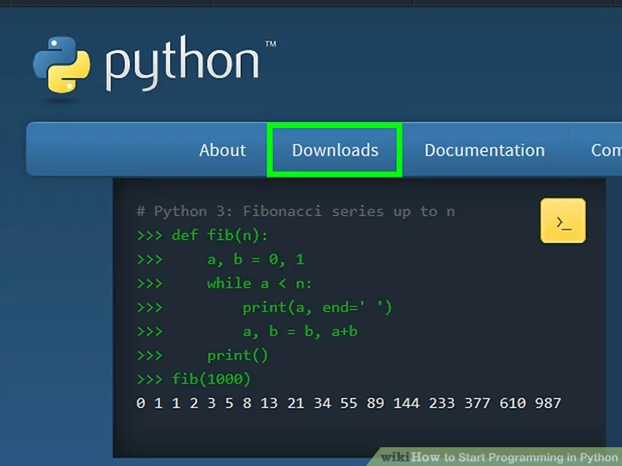

GCSE (9-1)
Specification
COMPUTER SCIENCE
By studying GCSE Computer Science as part of your programme of study, you will learn to understand and apply the fundamental principles and concepts of Computer Science: abstraction, decomposition, logic, algorithms, and data representation. You will also analyse problems in computational terms through practical experience of solving such problems including designing, writing and debugging programs. You will also learn how programming links to professional work practice, and you will be required to thinking creatively, innovatively, analytically, logically and critically when responding to the programming coursework brief.
There are two units that you will study for this GCSE:
•Computer systems (Unit1)
This component will introduce you to the internal workings of the Central Processing Unit (CPU), the exchange of data and will also look at software development, data types and legal and ethical issues.
•Computational thinking, algorithms and programming (Unit2)
This component will build on the knowledge and understanding gained in the previous component, developing your understanding of computational thinking. You will also be using algorithms to explain and solve problems. You will also be completing practical programming tasks in a suitable programming language.
You will be working with local and national computing, digital design and IT companies as part of the units you study and completing employer led projects throughout the course.
What’s included
Understanding the CPU, programming and project management, understanding algorithms, binary, hexdecimal, denary data types, digital design.

Slide 2
Key Features
Use of Raspberry Pi
Project planning
Web design
App development
Programming
Database design
Understanding data types
Understanding how to use computers in industry
,
Links to workplace
Designer
Programmer
Web designer
App designer
IT Consultant
Computer technician
IT Manager
Network design

