Slide 1
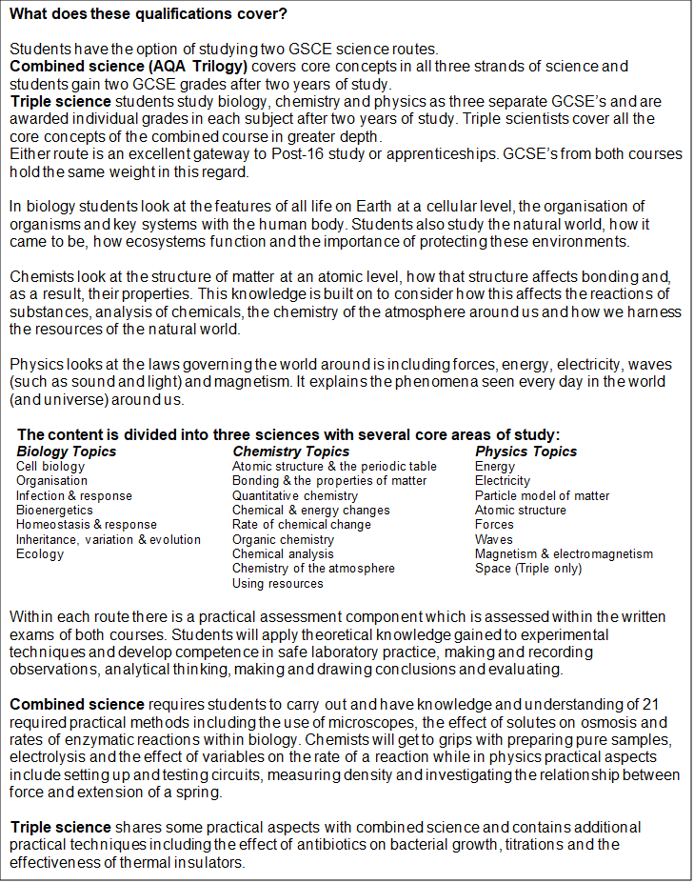
GCSE
Specification

Slide 2
