Slide 1
Cambridge Nationals
ENGINEERING - SYSTEMS & CONTROL
What does this qualification cover?
Our Cambridge National in Systems Control in Engineering introduces students to how microprocessor control systems are used in a variety of engineering environments. Students develop practical skills by designing, producing and testing the operation of simple electronic controls.
This qualification
is suitable for learners
Students learn about the fundamentals of electronic circuits and how they relate to the design, maintenance and repair of electrical/electronic systems used in engineering products. They design, construct and test electronic circuits using appropriate techniques, procedures and equipment, including fault-finding and identifying potential electrical hazards.
Students develop their knowledge and understanding of the construction techniques and processes used in the manufacture of electronic and electrical circuits. They use computer-based simulation software to prototype and test the operation of circuits and produce designs for printed circuit boards (PCB). They also learn how to evaluate the performance of a simple electronic circuit.
Grading
Examined units are graded Near-Pass, Pass, Merit and Distinction. Internally assessed units are graded Pass, Merit and Distinction. The qualification is graded PP, PM, MM, MD, DD, DD*, D*D*
Examinations / Resits
Learners can resit an examined unit twice before they complete the qualification.
Qualification Structure
Employer Involvement
Employers will be involved throughout the course and form an essential link to learning
Career Progression
Progression from OCR Level 1/2 Cambridge National Award/Certificate/in Engineering to Cambridge Technicals in Engineering at Level 2 and Level 3 creating pathways to: chemical engineering, civil engineering, electrical engineering, electronic engineering, mechanical engineering, product/industrial design engineering, software engineering
Assessment Method There is a range of internally assessed modules and externally set examinations set from the examining body OCR.
What’s included

Slide 2
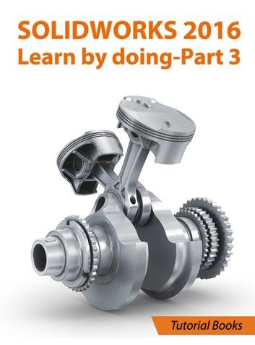
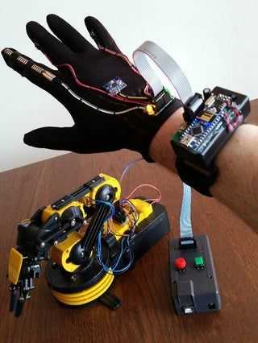
Key Features
Level 2 Engineering Systems and Control is essential for further Engineering courses and Engineering linked occupations, including electronics
Developing transferable skills that are widely recognised and applicable to the world of work including:
Problem Solving
Decision Making
Electronic systems and Programming
,
Links to workplace
By choosing to study Level 2 Engineering Systems and Control you will gain access to a wide range of potential occupations and A Level courses.
Links with employers will be an integral part of the course and will develop skills to enhance career opportunities.
You will developed a range of programming and electronics skills that can be utilised in further pathways.

