Slide 1
Cambridge Technicals
ENGINEERING – National Diploma
What does this qualification cover?
• 12 x 60 GLH units – at least four externally examined units and a choice of eight further units, either examined or centre-assessed and moderated by us, which will make up a specialist endorsed pathway.
Learners will be able to develop the core knowledge, skills and understanding the engineering sector requires. They will develop further skills by completing a wide range of units through a choice of these specialist pathways:
• Electrical and electronic engineering,
• Mechanical engineering and design,
• Automation, systems and control,
• Manufacturing.
This qualification
is suitable for learners...
Grading
Examined units are graded Near-Pass, Pass, Merit and Distinction. Internally assessed units are graded Pass, Merit and Distinction. The qualification is graded PP, PM, MM, MD, DD, DD*, D*D*.
...studying to prepare for employment in the engineering sector.
• Who want to progress into engineering-related apprenticeships.
• Who want to gain a Level 3 qualification to support further study in Further Education (FE) and Higher Education (HE) in Engineering.
Examinations / Re-sits
Learners can re-sit an examined unit twice before they complete the qualification.
Qualification Structure
Learners must achieve a total of 12 units consisting of 4 mandatory examined units and 8 further units. The choice of units will depend on the specialist pathway selected.
Employer Involvement
Employers will be involved throughout the course and form an essential link to learning.
Career Progression
This qualification could lead to Higher Apprenticeships, full time employment in engineering roles or form a basis for a higher education courses in engineering.
Assessment Method Units 1 to 4 and Unit 23 are assessed by exam and marked by us. Your centre staff will internally assess all the other units and we will moderate them.
What’s included
720 GLH equivalent to two A levels in terms of size.

Slide 2
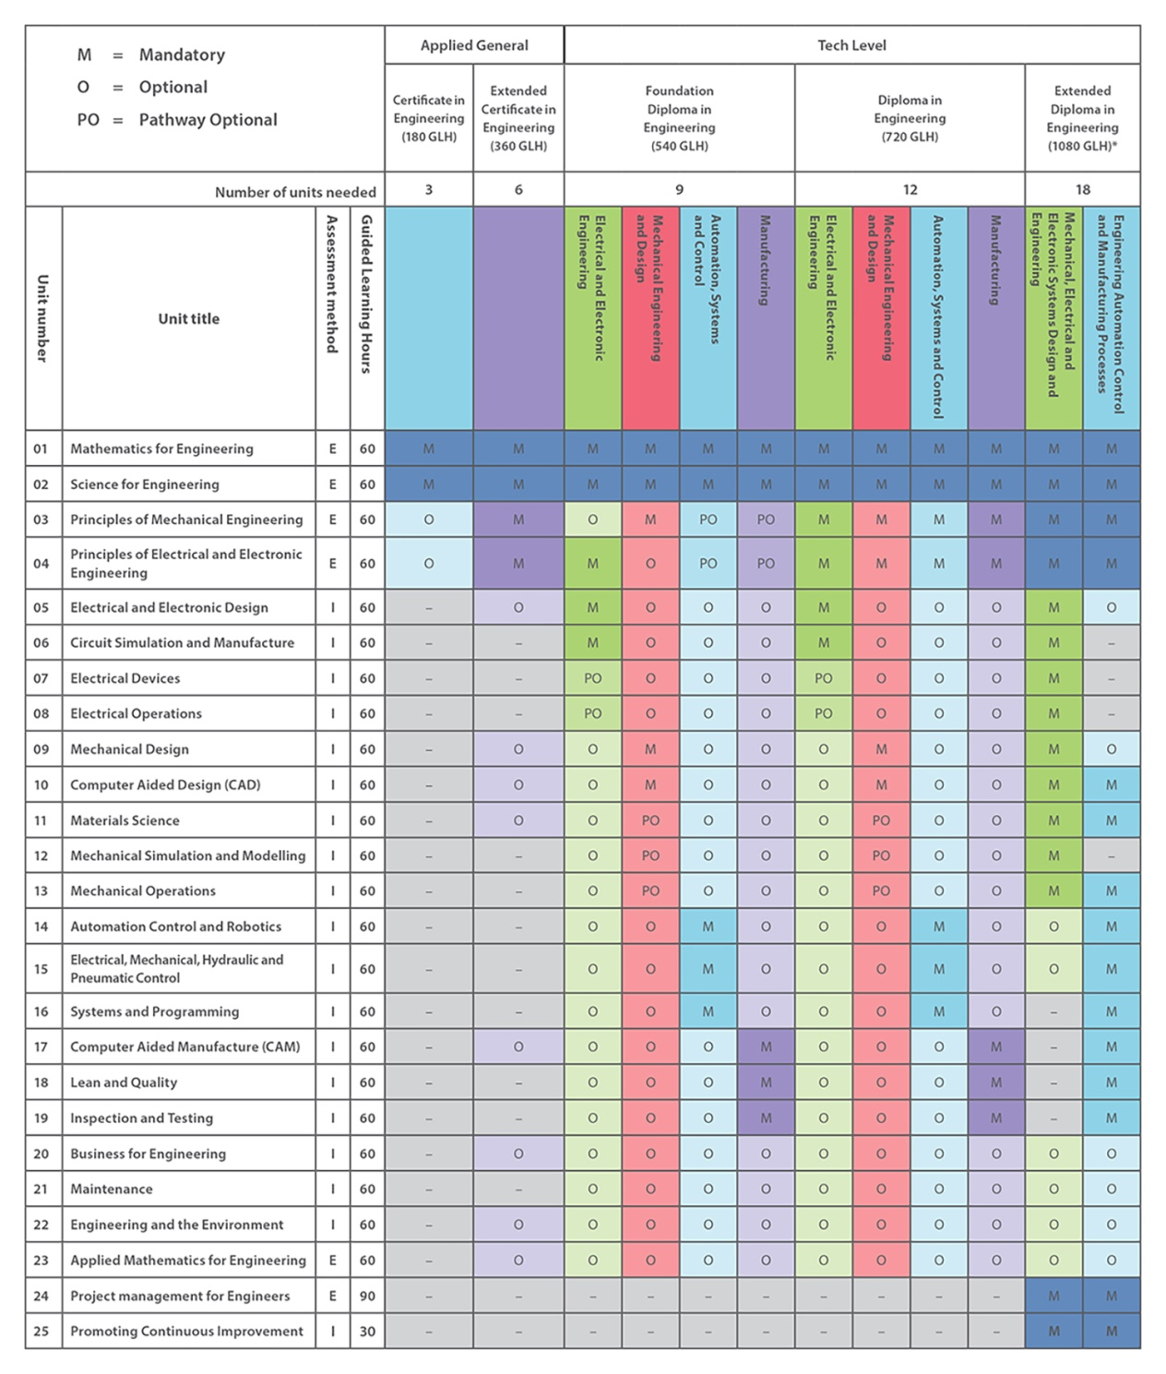
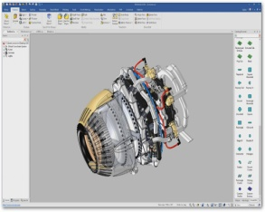
Key Features
A Level Engineering is essential for further Engineering courses and Engineering linked occupations.
Developing transferable skills that are widely recognised and applicable to the world of work including:
Problem Solving,
Decision Making,
Practical Capabilities,
Evaluative Strategies.
,
Links to workplace
By choosing to study A Level Engineering you will gain access to a wide range of potential occupations.
Links with employers and work experience will be an integral part of the course and will develop skills to enhance career opportunities.
Employer mentoring schemes will also be available to help prepare students for chosen pathways post A Level study.

