Slide 1
Cambridge Nationals
ENGINEERING MANUFACTURE
What does this qualification cover?
Our Cambridge National in Engineering Manufacture develops students’ understanding of the processes involved in transferring a design concept into a product. They apply their knowledge and skills by operating manufacturing equipment following a design specification, using tools such as CAD/CAM.
This qualification
is suitable for learners
This qualification will provide learners with the knowledge and skills in specialist areas of expertise. Areas include engineering operations and techniques; and maintenance of equipment and machinery
use technical knowledge, mathematical expertise and design skills to create innovative solutions to problems across a range of industries
You’ll be involved in the initial concept, design, development and management of projects in a range of sectors such as construction and the built environment, materials, software, components, machinery and vehicles.
To succeed you'll need strong technical knowledge, as well as problem solving, communication, leadership and project management skills.
Grading
Examined units are graded Near-Pass, Pass, Merit and Distinction. Internally assessed units are graded Pass, Merit and Distinction. The qualification is graded PP, PM, MM, MD, DD, DD*, D*D*
Examinations / Resits
Learners can resit an examined unit twice before they complete the qualification.
Qualification Structure
Employer Involvement
Employers will be involved throughout the course and form an essential link to learning
Career Progression
Progression from OCR Level 1/2 Cambridge National Award/Certificate/in Engineering to Cambridge Technicals in Engineering at Level 2 and Level 3 creating pathways to: chemical engineering, civil engineering, electrical engineering, electronic engineering, mechanical engineering, product/industrial design engineering, software engineering
Assessment Method There is a range of internally assessed modules and externally set examinations set from the examining body OCR.
What’s included

Slide 2
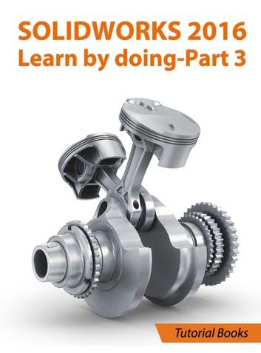
Key Features
Level 2 Engineering Manufacture is essential for further Engineering courses and Engineering linked occupations.
Developing transferable skills that are widely recognised and applicable to the world of work including:
Problem Solving
Decision Making
Practical Capabilities
Evaluative Strategies
,
Links to workplace
By choosing to study Level 2 Engineering Manufacture you will gain access to a wide range of potential occupations and A Level courses.
Links with employers will be an integral part of the course and will develop skills to enhance career opportunities.
You will developed a range of practical skills that can be utilised in further academic studies or occupational pathways.

