Slide 1




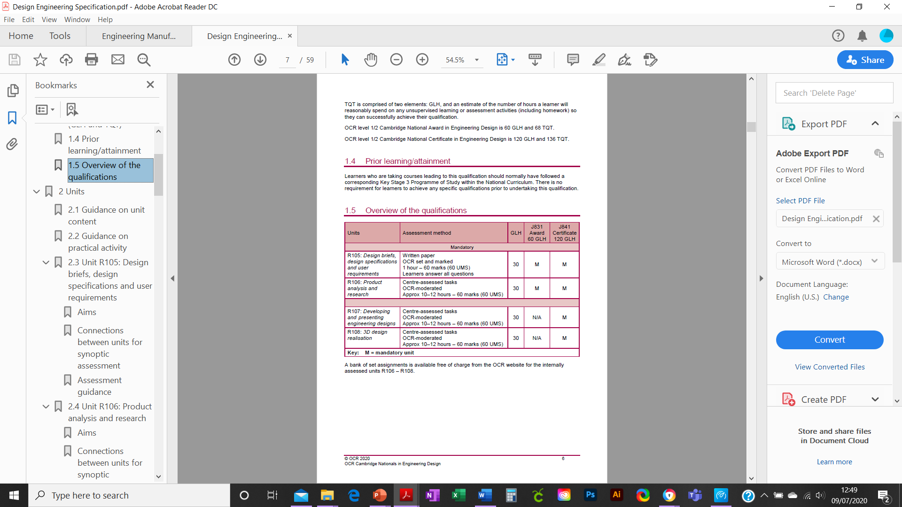
Cambridge Nationals
DESIGN ENGINEERING
What does this qualification cover?
Design Engineering: Briefs, design specifications, development of new products, consumer requirements, design cycle, product life cycles, improved methods & materials, machine and hand processes, CAD / CAM
This qualification
is suitable for learners
Design engineers use technical knowledge, mathematical expertise and design skills to create innovative solutions to problems across a range of industries
As a design engineer you're involved in the initial concept, design, development and management of projects in a range of sectors such as construction and the built environment, materials, software, components, machinery and vehicles.
To succeed you'll need strong technical knowledge, as well as problem solving, communication, leadership and project management skills.
Depending on their specialist area, design engineers may also be known as CAD engineers, consulting engineers and product design engineers
Grading
Examined units are graded Near-Pass, Pass, Merit and Distinction. Internally assessed units are graded Pass, Merit and Distinction. The qualification is graded PP, PM, MM, MD, DD, DD*, D*D*
Examinations / Resits
Learners can resit an examined unit twice before they complete the qualification.
Qualification Structure
Employer Involvement
Employers will be involved throughout the course and form an essential link to learning
Career Progression
Progression from OCR Level 1/2 Cambridge National Award/Certificate/in Engineering to Cambridge Technicals in Engineering at Level 2 and Level 3 creating pathways to: chemical engineering, civil engineering, electrical engineering, electronic engineering, mechanical engineering, product/industrial design engineering, software engineering
Assessment Method There is a range of internally assessed modules and externally set examinations set from the examining body OCR.
What’s included

Slide 2
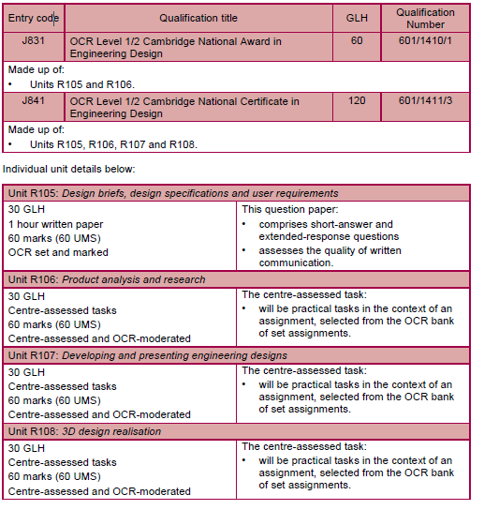
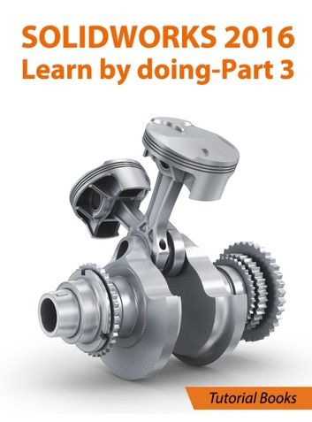


Key Features
Level 2 Engineering Design is essential for further Engineering courses and Engineering linked occupations, including Architecture.
Developing transferable skills that are widely recognised and applicable to the world of work including:
Problem Solving
Decision Making
Design Strategies and Techniques
Evaluative Strategies
,
Links to workplace
By choosing to study Level 2 Engineering Design you will gain access to a wide range of potential occupations and A Level courses.
Links with employers will be an integral part of the course and will develop skills to enhance career opportunities.
You will develop a range of design strategies and techniques that can be utilised in further academic studies or occupational pathways.

