Slide 1




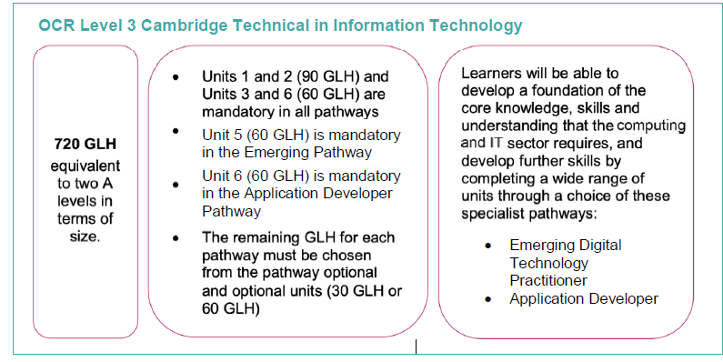
Cambridge Technicals level 3
INFORMATION TECHNOLOGY
What does this qualification cover?
By studying the L3 CAMTECH Diploma in Information Technology, you will choose to learn computing and information technologies from one of two specialist pathways, depending on your interests and career you may wish to pursue. The qualification is equivalent to studying two A Levels. The two pathways we will be studying are:
• Emerging Digital Technology Practitioner (covering virtual and augmented reality, cyber security, project development and social media and digital marketing)
• Application Developer (covering web and app development, games design, cyber security and developing business solutions).
You will take between eight units and ten units; three are mandatory across both pathways, and then you will also have to take one mandatory pathway specific unit.
There two mandatory units that are across all pathways are: Fundamentals of IT, Global Information and Cyber Security. These units will your understanding of how computing and information technology is at the heart of global commerce and design.
You will be working with local and national computing, digital design and IT companies as part of the units you study and completing employer led projects throughout the course.
What’s included
Planning, VR, AR, networking, coding, programming skills.

Slide 2
Emerging Digital Technology Practitioner
You will take the designated mandatory unit for this pathway – Virtual and Augmented Reality. In this unit you will develop a Virtual and an Augmented Reality resource to support key digital and production sectors of 3D modelling, structural planning and architecture, engineering and the games industry. The VR and AR resource that you will design will be commissioned by an employer. You will have the opportunity to present your ideas, prototype them and gain feedback before refining their design.
As part of this pathway, the optional units you can take are Developing a Smarter Planet, Mobile Technologies, Big Data Analytics and Computer Software Systems.
Application Developer
You will take the designated mandatory unit for this pathway – Application Design. In this unit you will develop potential ideas for a new application and develop the fundamental design for it. You will then develop the designs for an application and how users will interact with it. The application that you will design will be commissioned by an employer. You will have the opportunity to present your ideas, prototype them and gain feedback before refining their design.
As part of this pathway the optional units you can take are Social Media and Digital Marketing, Games Design and Prototyping, Big Data Analytics and Web Design and Prototyping.
Key Features
Working to employer briefs
Links to IT industries
Use of Raspberry Pi
Graphic design
Web design
App development
Programming
Database design
Links to workplace
Designer
Programmer
Web designer
App designer
IT Consultant
Computer technician
IT Manager
Network design

