Slide 1
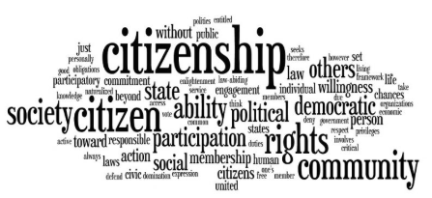
Cambridge Nationals
Citizenship
What does this qualification cover?
GCSE Citizenship Studies has the power to motivate and enable young people to become thoughtful, active citizens.
Why study Citizenship? What will I study?
Students gain a deeper knowledge of democracy, government and law, and develop skills to create sustained and reasoned arguments, present various viewpoints and plan practical citizenship actions to benefit society.
They will also gain the ability to recognise bias, critically evaluate argument, weigh evidence and look for alternative interpretations and sources of evidence, all of which are essential skills valued by higher education and employers.
Citizenship studies investigates how the citizen is enabled by society to play a full and active part and how citizens are empowered to effect change within society. Citizenship understanding develops through the knowledge of how a society operates and functions and its underlying values.
Life in modern Britain, looks at the make-up and dynamics of contemporary society, what it means to be British, as well as the role of the media and the UK’s role on the world stage.
Rights and responsibilities, looks at the nature of laws, rights and responsibilities within the UK and has a global aspect due to the nature of international laws, treaties and agreements by which the UK abides.
Politics and participation, aims to give the student, through an understanding of the political process, the knowledge and skills necessary to understand how to resolve issues, bring about change, and how the empowered citizen is at the heart of our society.
The opening section of each theme outlines the ‘key concepts’.
Within each of these themes there is a requirement that students develop and apply citizenship skills and gain an understanding of the following processes and methods related to issues arising from the subject content.
Subject Content Areas
Citizenship skills, processes and methods
Life in modern Britain
Rights and responsibilities
Politics and participation
Active citizenship
Assessment Method There are two externally assessed examinations set by the exam body AQA, which are sat at the end of the two year course..

Slide 2
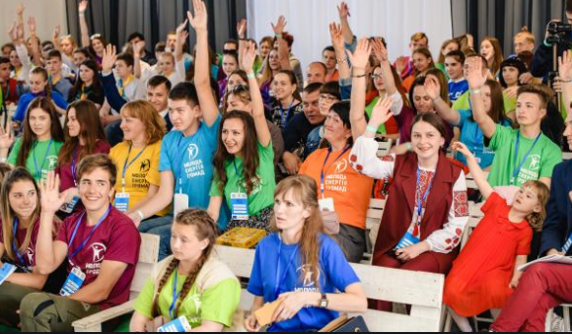
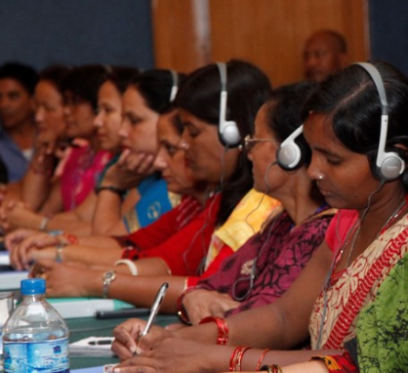
Assessment
Paper 1: What's assessed Section A: Active citizenship Section B: Politics and participation
How it's assessed Written exam: 1 hour 45 minutes 80 marks 50% of GCSE
Questions Section A: Active citizenship questions: questions on the citizenship action of others and questions on the students taking citizenship action investigation (40 marks) Section B: Politics and participation question (40 marks) Question types: multiple-choice, short answer, source-based questions, extended answer
Paper 2: What's assessed Section A: Life in modern Britain Section B: Rights and responsibilities
How it's assessed Written exam: 1 hour 45 minutes 80 marks 50% of GCSE
Questions Section A: Life in modern Britain questions (40 marks) Section B: Rights and responsibilities questions (40 marks) Question types: multiple-choice, short answer, source-based questions, extended answer
Employability skills
By studying citizenship you will become self motivated and responsible learners, who relate positively to each other, to staff and to the surrounding community. For society it helps to create an active and responsible citizenry, willing to participate in the life of the nation and the wider world and play its part in the democratic process.
Future employment pathways
The study of GCSE citizenship can lead into numerous pathways in the future:
politics
media
journalism
civil service
economics
law

