Slide 1
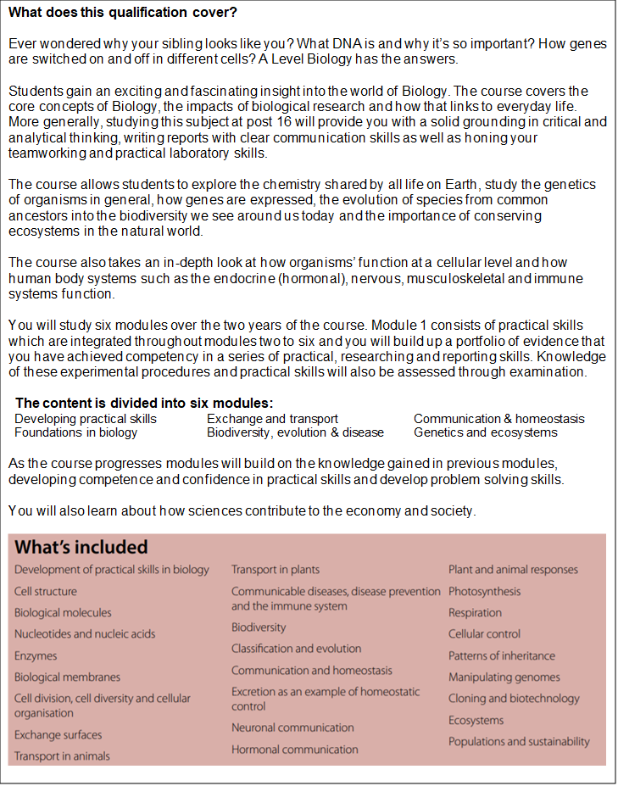
ALEVEL
Specification
BIOLOGY

Slide 2
